Slide 2
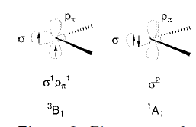
The Carbenes:
A carbene may be defined as a mononuclear, divalent, Carbon(II) compound.
Carbenes are generally considered as one of the most short lived species in laboratory, however they can exist as stable entity in the interstellar medium.
Have played an important role as transient species since last six decades starting from its introduction by Doering in 1950’s.
:CH₂ exists as triplet ground state.

Slide 3

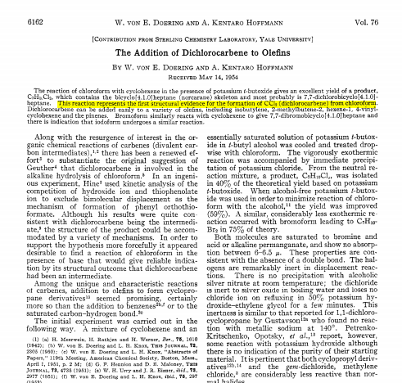
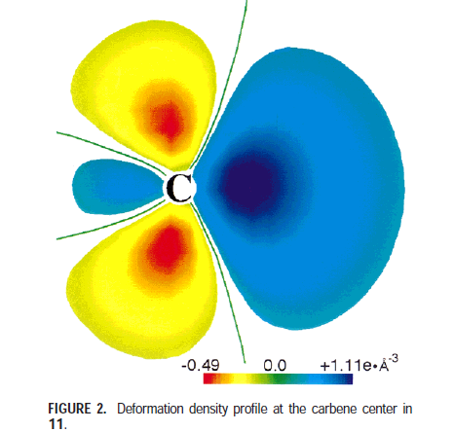
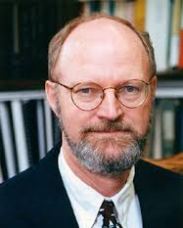

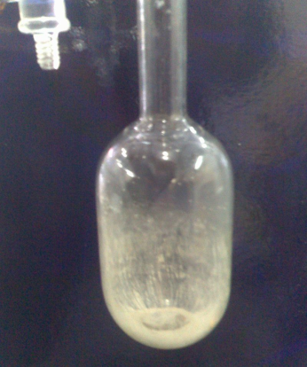
Carbene: N-Heterocyclic Carbene (NHC) Chemistry
Intermediacy of
X₂C:
Wanzlick
Equilibrium
Doering et al.
First isolable
carbene
First Bottle-able
carbene
Nobel Prize
Wanzlick et al.
1835
1954
1958
1962
1967
1980
1988
1991
2005
Dumas et al.
Breslow et al.
Hoffmann et al.
Pauling et al.
Bertrand et al.
Arduengo III et al.
Robert H. Grubbs
Dreams
of isolating
H₂C:
Breslow
Intermediate
Theoretical
Prediction
(Singlet-Triplet)

Slide 4
Carbenes
smallest thinkable carbene
Dumas et al. Ann. chim. Phys. 1835, 58, 5-74.
“Now it will be my next task to prepare methylene or derivatives of it which are free of nitrogen; a number of observations already suggest that such substances can exist…”
J. U. Nef et al. Justus Liebigs Ann. Chem. 1897, 298, 202-374.

Slide 5
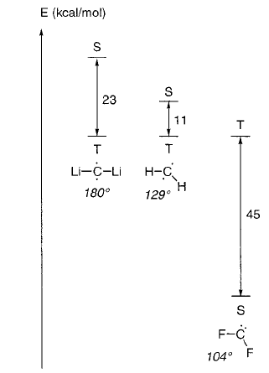
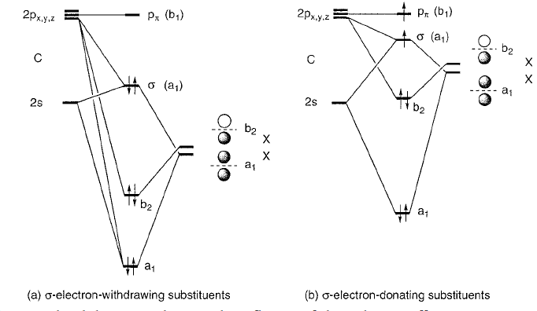
Singlet or Triplet?
Bertrand and Coworkers Chem. Rev. 2000, 100, 39-91

Slide 6
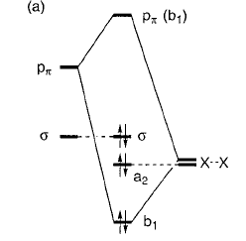
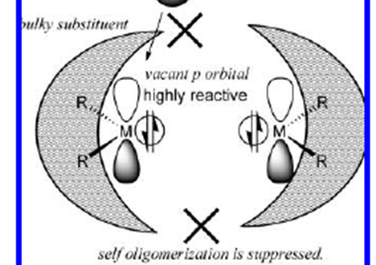
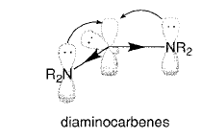
Mesomeric Effect
R. Hoffmann determined at least 2 ev difference to stabilize carbene singlet ground state
Kinetic Effect

Slide 7
1962
First N-Heterocyclic carbene
Wanzlick Equilibrium
H. -W. Wanzlick, Angew. Chem., Int. Ed., 1962, 1, 75-80.

Slide 8
The First Stable Carbene
1988
(Phosphino)silyl carbene
first isolable carbene
stabilized by adjacent phosphorus and silicon substituents
Bertrand et al. J. Am. Chem. Soc., 1988, 110, 6463–6466.
carbene proved to be poor ligand due to strong P-C_{carbene} multiple bond character

Slide 9
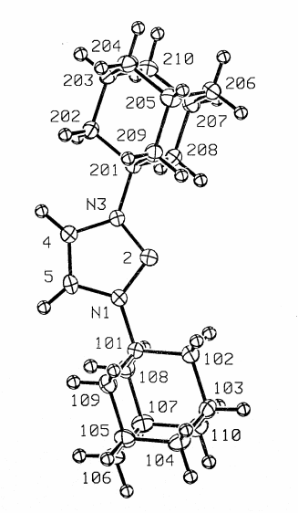
The First Bottle-able and Isolable Carbene
First crystalline carbene
Crystallized in toluene at low temp
Stable in air and moisture-free conditions
Colourless solid
Demonstrated that free carbenes are not invariably reactive, unstable reaction intermediates.
Arduengo III et al. J. Am. Chem. Soc., 1991, 113, 361–363.

Slide 10
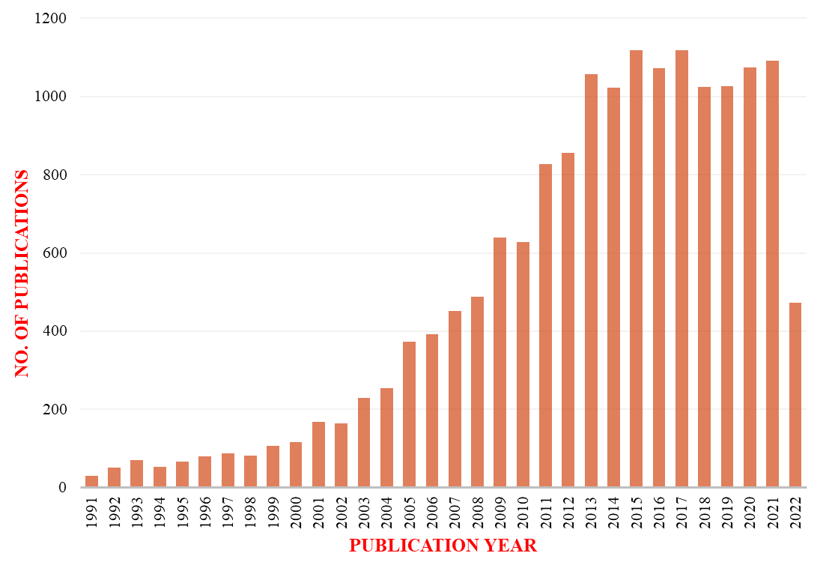
Growth of N-Heterocyclic Carbene Chemistry
SciFinder search as obtained on 17.07.2022. Search results were taken as entered for the topic ‘‘N-heterocyclic carbene’. Document type was refined to Journal and Review. Duplicates were removed. Results were analyzed by the publication year and exported.

Slide 11
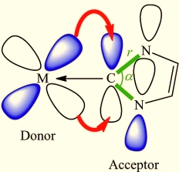
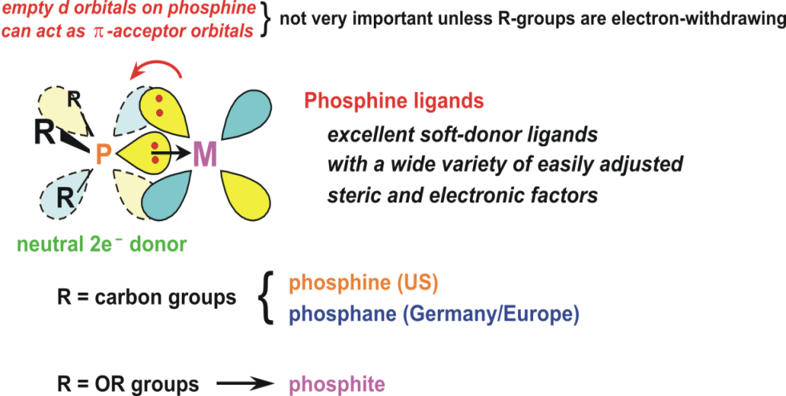
Why Singlet Carbene is Important in Catalyst Design?
NHC salt is stable (which is used for metal catalyst development), it has two electrons for donation to metal orbital.
It has empty orbital to accept electron
Hence NHC can be considered as ambiphilic in nature

Slide 12
NHC in catalysis

Slide 13
NHC in Grubbs Catalyst
Robert H. Grubbs:
Nobel Prize in 2005
Grubbs II is catalytically more active than Grubbs I
Grubbs et al. Org. Lett., 1999, 1, 953–956.

Slide 14
An Overview on N-heterocyclic Carbene
Glorius, Nature, 2014, 510, 485-496.

Slide 15
Classification of NHCs
Classical Carbenes
Non-Classical Carbenes

Slide 16
Protecting the Unstable Species
Advantage of Carbene: Electronic synergy
Science 2008, 321, 1069–1071. (steric and electronic stabilization)

Slide 17
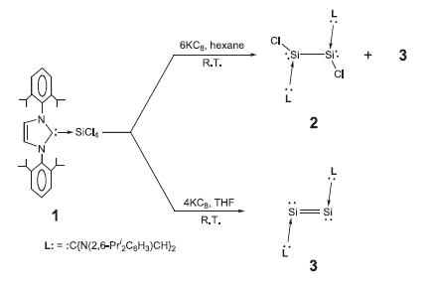
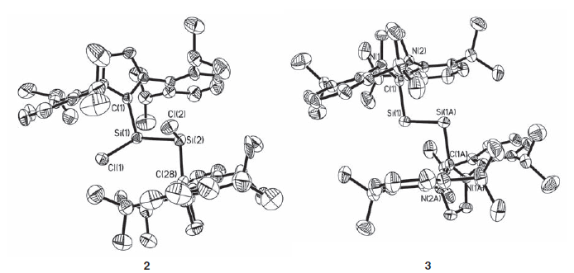
Stabilization of Different Oxidation State
Schleyer, Robinson and coworkers Science 2008, 321, 1069-1071
Mandal and Roesky Chem. Commun. 2010, 46, 6016–6041 (Highlighted on front cover)

Slide 18
Power, Nature, 2010, 463, 171-177
Power and co-workers Science 2009, 325, 1668–1670.
Braunschweig and co-workers Science 2018, 359, 896-900
Bertrand and coworkers Science 2007, 316, 439-441

Slide 19

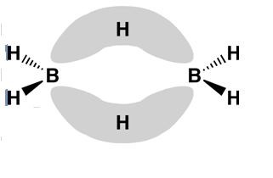

Reversing Chemical Property: Nucleophilic Boron!
Angry Pair Effect!
Group 13 elements
Lewis Acceptor
Elements | Electronic config.
B | [He]2s²2p¹
Al | [Ne]3s²3p¹
Ga | [Ar]3d¹⁰4s²4p¹
In | [Kr]4d¹⁰5s²5p¹
Tl | [Xe]4f¹⁴5d¹⁰6s²6p¹
Dimerization of BH₃
(Nobel Prizes in Chemistry
1976 W Lipscomb and
1979 HC Brown)
Inert Pair Effect
B(I) compounds with an active pair of electrons :
RB:(I) ---(Borylene)----

Slide 20
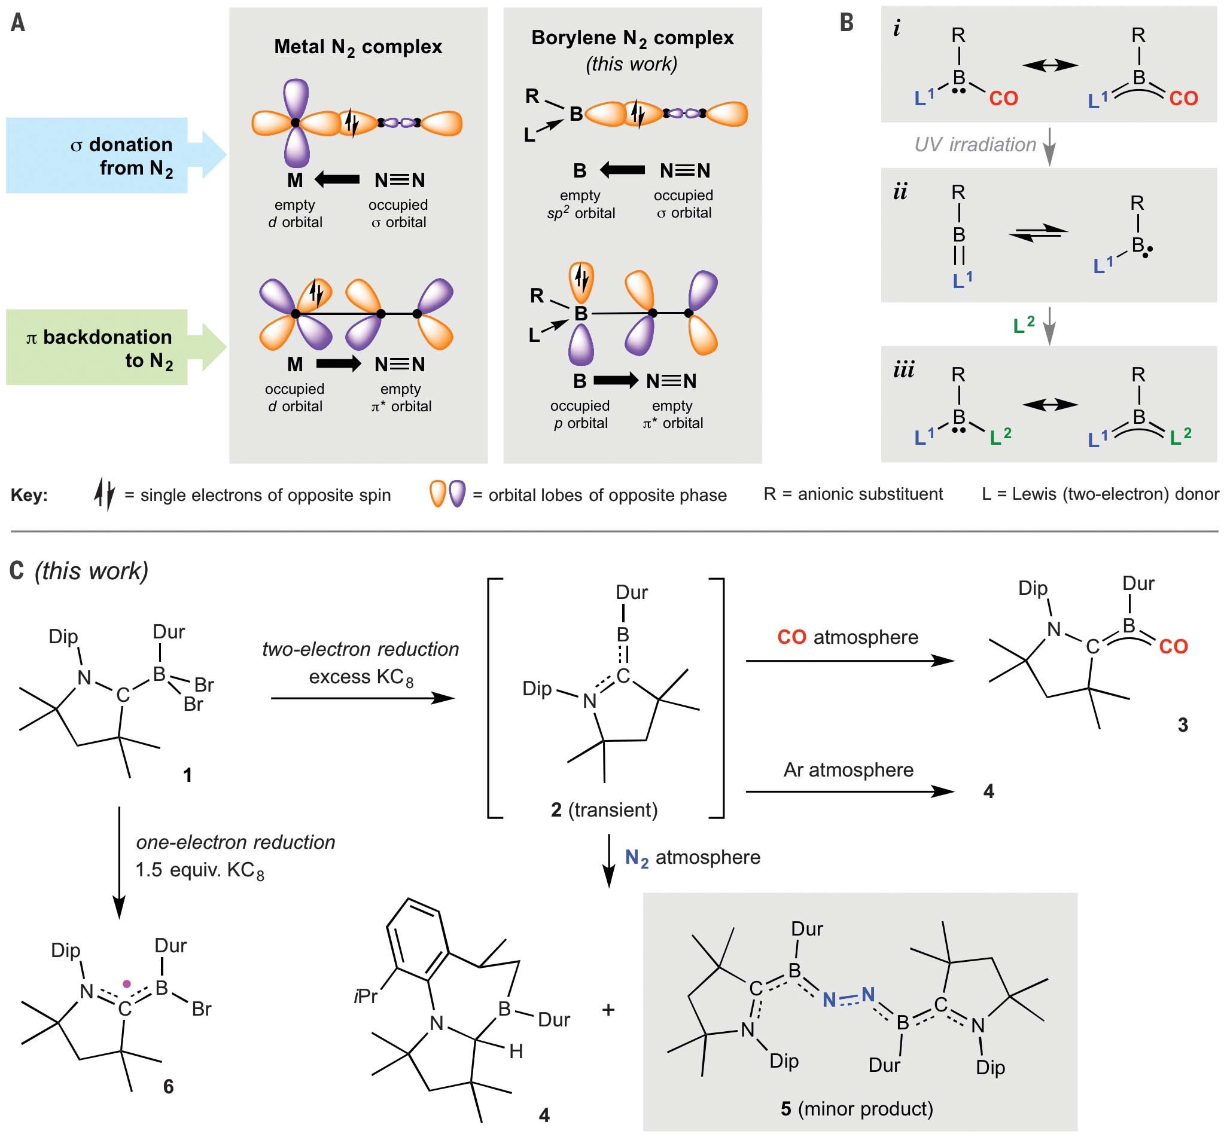
H Brauschweig et al Science 359, 896–900 (2018) and Science 363, 1329–1332 (2019)

Slide 21
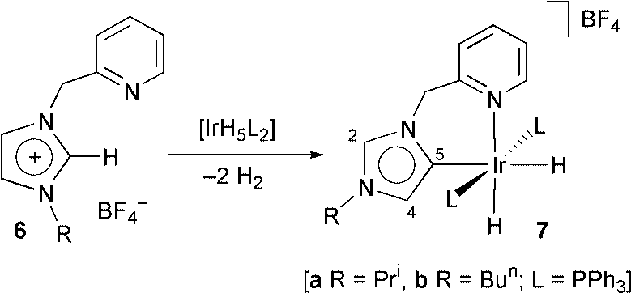
New Turn in NHC Chemistry: Year 2009
Normal N-heterocyclic carbene, developed by Arduengo et al (J. Am. Chem. Soc. 1991, 113, 361–363)
Chem. Commun., 2001, 2274–2275
(Crabtree , Faller and coworkers)
Isolated abnormal N-heterocyclic carbenes (also called non classical carbenes) were considered elusive species and in 2009…

Slide 22
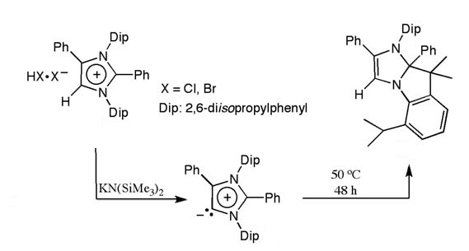
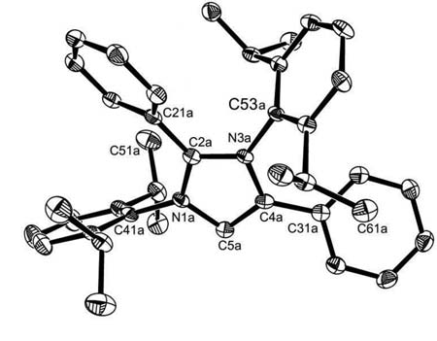
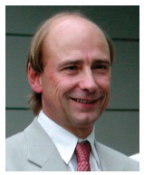
Bertrand and coworkers Science 2009, 326, 556-559
“Normal carbenes rapidly became a key tool for organometallic chemistry and organic synthesis once they were available as stable free ligands some 20 years ago. Given the unique impact of abnormal carbenes on the reactivity of transition metals, the accessibility of free abnormal carbenes may become another cornerstone in this field, and it will be exciting to witness developments in these directions.”
Martin Albrecht, Science 2009, 326, 532-533

Slide 23
NHC’s are very good donors and aNHC’s are even better!
N-heterocyclic carbenes (NHCs) represent a particularly attractive class of ligands for such applications, since they belong to the class of the strongest neutral donors known.
Application of newly Reported Abnormal N-heterocyclic Carbene:
1. As organocatalyst since it will be better nucleophile than normal NHCs.
2. As building block for organometallic catalysts since Abnormal N-heterocyclic Carbene will have better metal holding capacity will result no leaching and catalyst poisoning.

Slide 24
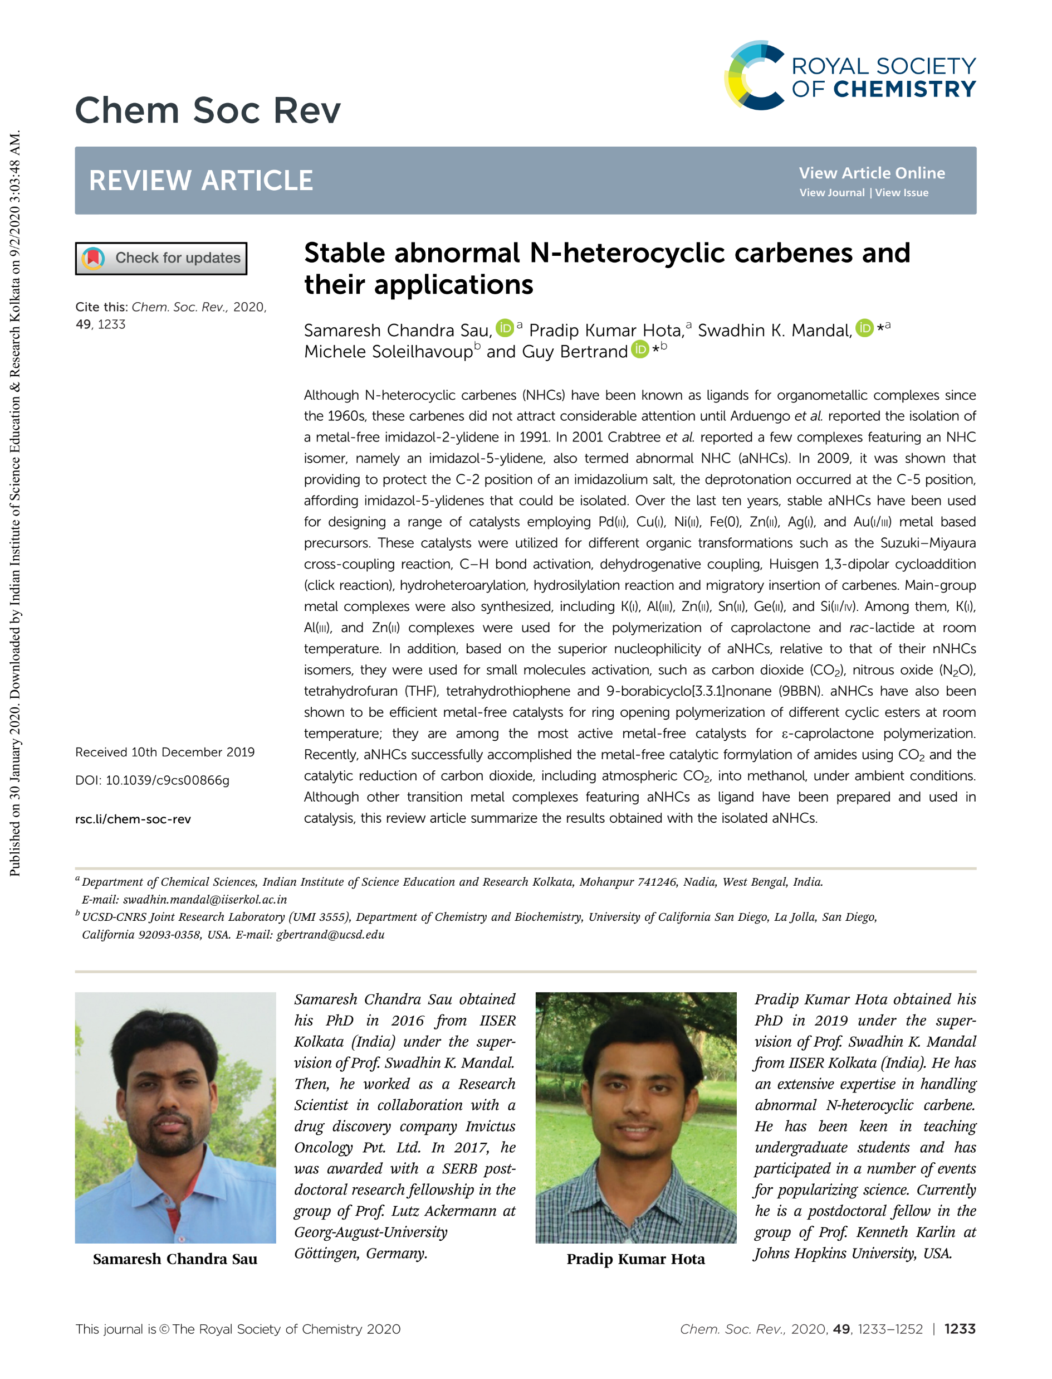

Slide 25
Abnormal N-heterocyclic Carbene in Homogeneous Catalysis
C-C coupling, Reduction of various functional groups.
Ring opening polymerization
C-C coupling
CO₂ conversion and functionalization
Mandal, Bertrand et al. Chem. Soc. Rev., 2020, 49,1233-1252

Slide 26
Hydrogenation
Hydrogenation is a class of chemical reactions which result in an addition of hydrogen atoms across the un-saturated bonds of a molecule.
Known since the Sabatier process discovered in 1897
CO₂ + 4H₂ → CH₄ + 2H₂O (Nickel Catalyst)
Palladium, Platinum, Rhodium, Ruthenium and Raney Nickel catalysts: Activate Molecular Hydrogen.

Slide 27
Hydrogen activation in Nature
A hydrogenase is an enzyme that catalyses the activation of H₂ into two protons and two electrons.
Bridged by two cysteic thiolates and one unidentified ligand (depicted as X in Fig. 1).The bridging ligand X in the resting state is proposed to be an oxygen ligand such as H₂O, OH–, or O^{2–} .

Slide 28
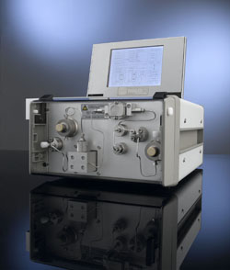
Other than routine Chemical Synthesis…
Scope of the Reaction:
Hydrogenation is widely applied in the processing of vegetable oils.

Slide 29
L-Dopa Synthesis: Asymmetric Catalysis
Parkinson's disease is a degenerative disorder of the central nervous system that often impairs the sufferer's motor skills and speech.
The primary symptoms of PD are tremor, or trembling in hands, arms, legs, jaw, and face; rigidity, or stiffness of the limbs, or slowness of movement, or impaired balance and coordination.

Slide 30
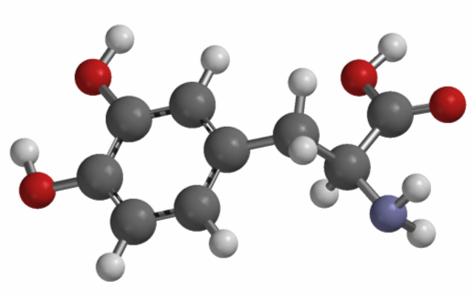
Synthetically…

Slide 31
Key Players in the field:

Slide 32
Synthesis of Anti-inflammatory Drug:

Slide 33
Hydrogen Activation by
Organometallic Catalysts

Slide 34
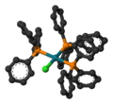
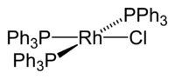
Hydrogen Activation- But How?
Wilkinson's Catalyst, 1965
The H-H bond is strong (103 kcal/mol) and requires metal catalyst but how exactly?

Slide 35
Famous discovery by Kubas et al.: Careful Observation
16 e Complex

Slide 36
16 e Complexes
What is the Structure of this Yellow complex??
IR did not show any characteristic band (for M-H) between 1700-2300 cm⁻¹ !! “ the bonding of the hydrogen to these metal complexes may be novel” –Chem. Commun. 1980, 61.

Slide 37
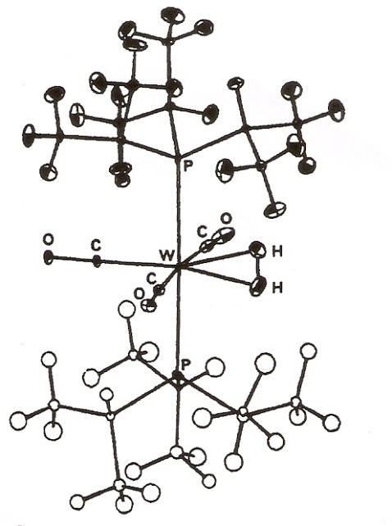
Single Crystal X-ray diffraction was frustrating: Location of the hydrogen.
Neutron diffraction study needed very large crystals (10 mm³) and Neutron diffraction data at 173 K confirmed the presence side on bonded dihydrogen metal complex.
H-H bond distance -0.84 Ǻ (free H-H distance 0.74 Ǻ)
J. Am. Chem. Soc. 1984, 106, 451

Slide 38
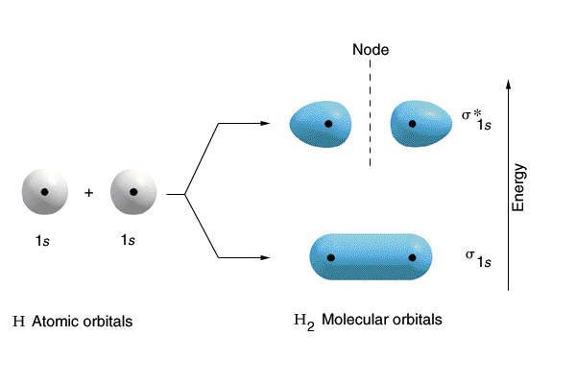
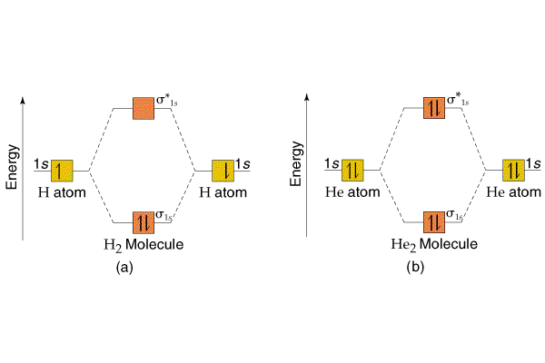
Metal-hydrogen bonding

Slide 39
Spectroscopic Proof: NMR
J HD = 33 Hz observed

Slide 40
Why this is so special?
Mechanism of Wilkinson’s catalyst was established by 1965 considering metal dihydride was the intermediate.
Metal dihydrogen was only speculated as possible transient species in the process of metal dihydride formation.
This discovery opened a new era to understanding of the hydrogen activation.

